Slide 1
Investigating an Algae Bloom

Slide 2
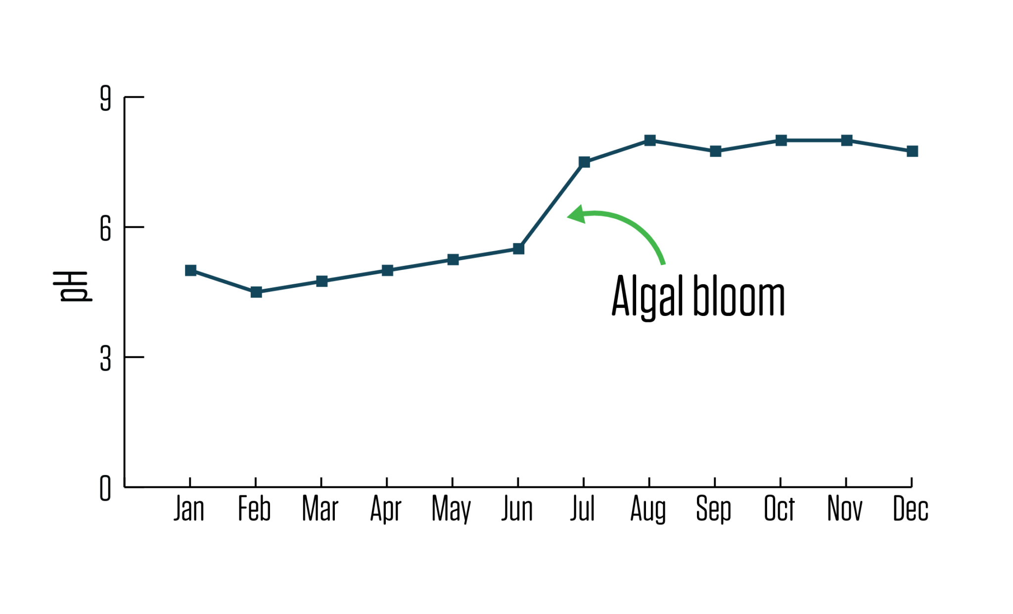
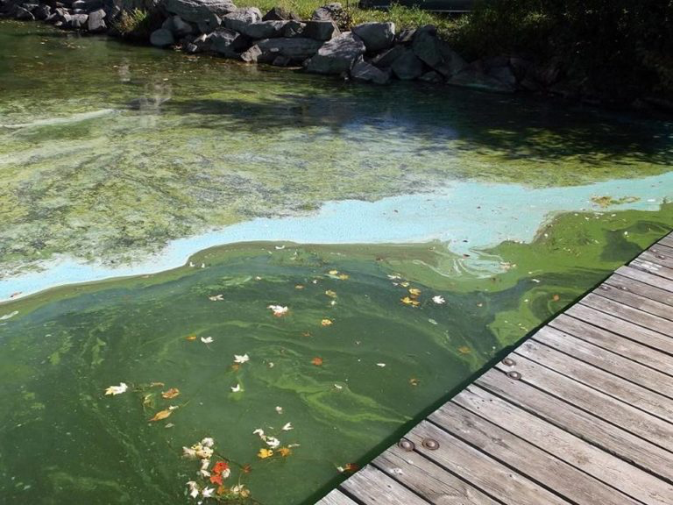
WHAT IS AN ALGAE BLOOM?
When water quality conditions are right for algae, a type of aquatic plant, to grow rapidly, it can quickly take over a water body causing what is known as an algae bloom. They are a major problem in many Canadian lakes!
Algae Blooms have many negative impacts on lakes!
Decreased oxygen
Decreased clarity
Blue-Green Algae, one type of algae bloom, is extremely toxic

Slide 3
ALGAE CHARACTERISTICS
Green algae
Blue-green algae
Pollen
Green and blue-green algae are common types found in water bodies. Sometimes pollen in water can be mistaken for algae.
Algae need warm temperatures and high levels of nitrogen and phosphorous to bloom.
Algae lack roots, stems, or leaves like aquatic plants.

Slide 4
BIG QUESTION
Does the landscape around a lake influence potential algae blooms?
What Do You Think?
Discuss with a classmate
Draw a picture
Explain your hypothesis

Slide 5
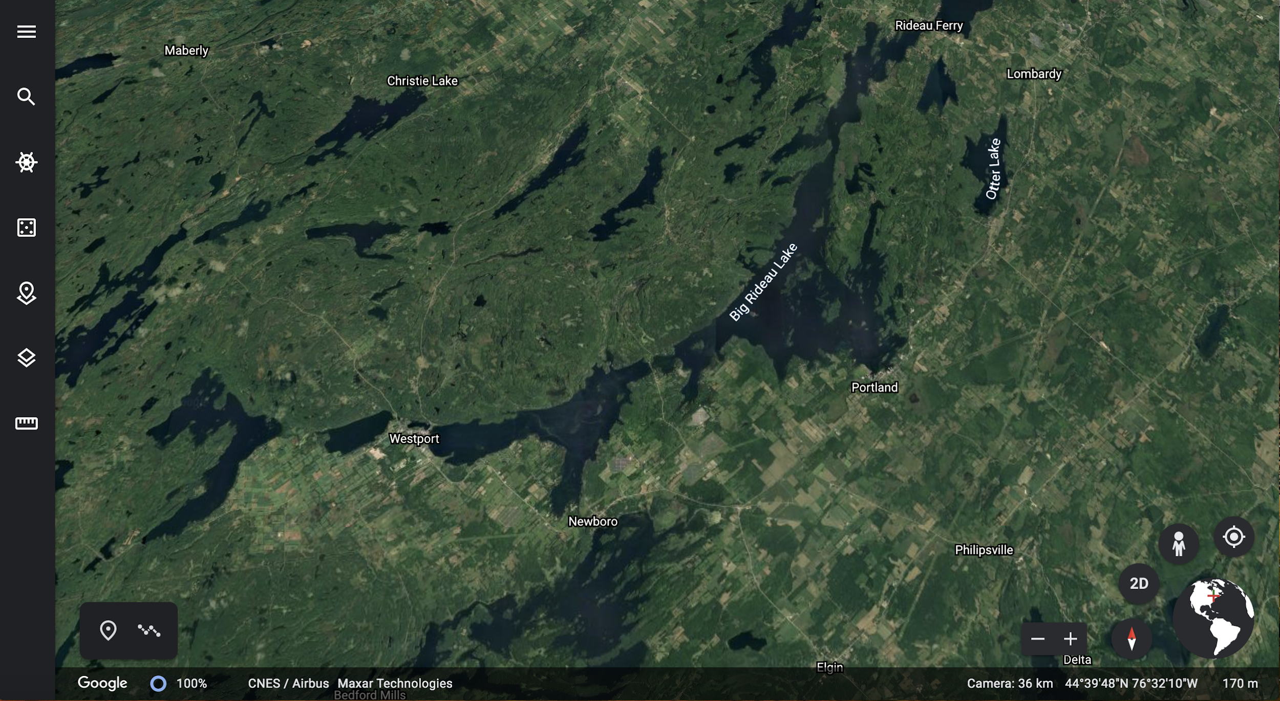
01
Explore the Map
Take a look at Big Rideau Lake on Google Maps. Big Rideau is a popular summer cottage lake, and it has a lot of boat traffic as they move through the Rideau Canal.

Slide 6
01
Explore the Map
How do you think the runoff differs between the North and South shores of Big Rideau?
How would this difference influence algae blooms?
Revise your picture with what you learned!

Slide 7
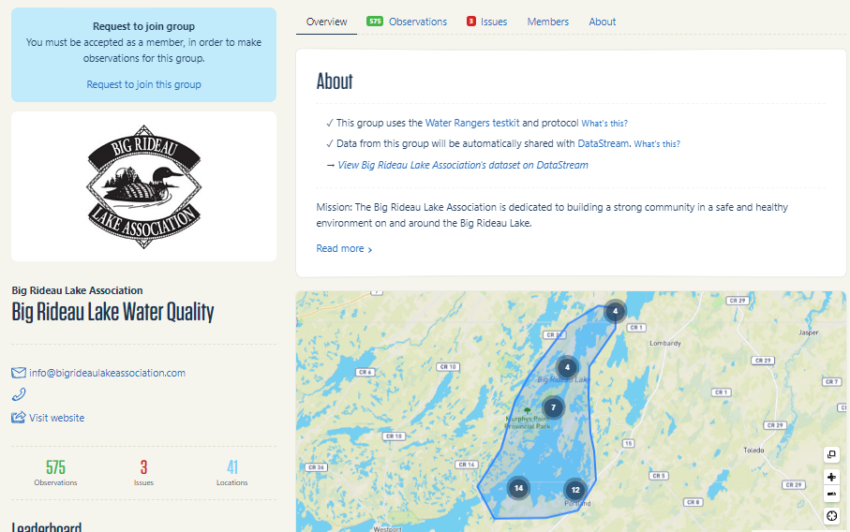
02
Introducing Big Rideau Lake Association
Committed to fostering a safe and healthy environment in the lake community, they’ve been collecting data going back to 1986!
Make a hypothesis: do you think this issue occurred on the North or South shore of the lake? Why?

Slide 8
Use Big Rideau Lake Association data to explore different sections of the lake, focusing on:
North: Rideau Ferry Marina, O’Mearas Bay
South: Narrows Red Buoy, Big Rideau at Hudson’s Bay
And, if time permits:
East: Klautz Pt , Briton Bay
West: End of Noble’s bay, Hogg’s Bay
03
Data exploration
Revise your picture with what you learned!

Slide 9
JENNA DOE
JACK DOE
Share with the Class
04
Talk a bit about this person
Talk a bit about this person
All our pictures probably look a bit different. Some of our hypotheses may be very different!
Scientists learn by sharing with each other, combining ideas, and debating.
Share your pictures of algae blooms with your class and come to a consensus on where you think the bloom occurred on Big Rideau

Slide 10
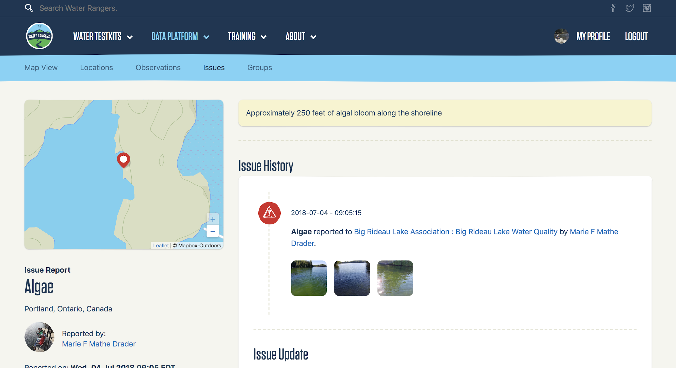
05
Incident Report
These are the issue reports of an algae blooms documented in the area:
Report #1: Hudson’s Bay
Report #2: Briton Bay
Report #3: Near Klautz Point
Revise your picture with what you learned!

Slide 11
05
Incident Report
Zoom out on the map on the left-hand side of the incident reports to see where the bloom occurred. Does it fit your hypothesis?
Discuss why or why not
Revise your picture with what you learned!

Slide 12
06
Revisit Google Maps
Take a look again at Big Rideau Lake on Google Maps and find where the blooms occurred. What could have contributed to the blooms in that area?

Slide 13
07
REACH FURTHER
How do people affect how runoff drives the water quality of Big Rideau? How might that change in the future? Read this article to find out about issues of development, land cover change, and phosphorus on Big Rideau and explore social-ecological connections.

Slide 14
Good Work!
Questions?
Email our education coordinator at praise@waterrangers.ca
]]
Learn more about community science and water quality testing at waterrangers.ca

